Slide 1
B-Trees
Chaklam Silpasuwanchai
July 15, 2019

Slide 2
Readings
Chapter 18-19, B-Trees, Cormen et al. (2009). Introduction to Algorithms, Third Edition (3rd ed.). The MIT Press.
https://ece.uwaterloo.ca/~dwharder/aads/
https://ocw.mit.edu/courses/electrical-engineering-and-computer-science/6-046j-design-and-analysis-of-algorithms-spring-2015/recitation-notes/MIT6_046JS15_Recitation2.pdf
https://www.udemy.com/user/mohammed-abdul-bari-2/

Slide 3
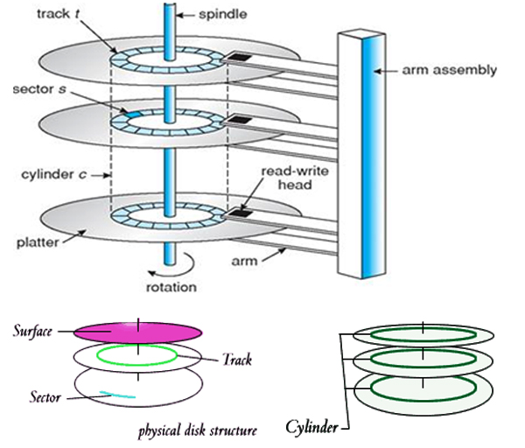
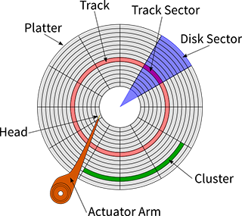
Disk Structure
Spinning change sector, arms extension change tracks
Source: GeraldComputerLab
Source: http://www.sakshieducation.com
To reach a block, one can access the block number with the information of track no. and sector no, i.e., Block address = (Track #, sector #)
0
Each byte of the block Structure is accessible using offset
511

Slide 4
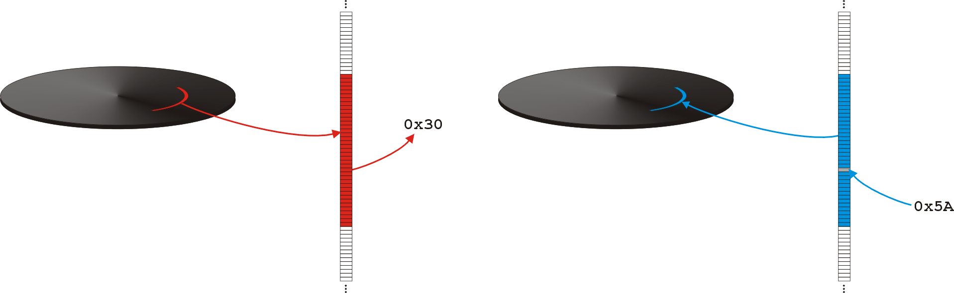
Block Structure
Hard drives are block addressable
To access a byte from a block, we must load the entire block containing it
To access or modify, blocks should be first copied to the main memory (# of disk accesses)
Then the main memory will process the data (CPU time)

Slide 5
Some example of database tables
eid | name | dept..
1 | Chaky | ...
2 | John | ...
3 | Tom | ...
4 | Marco | ...
5 | Alex | ...
6 | Khan | ...
7 | Sudra | ...
Let’s say that we have 100 records
Assume that each block is 512 bytes
Assume that
eid takes 10 bytes
name takes 50 bytes
dept takes 10 bytes
section takes 8 bytes
address takes 50 bytes
Total is 128 bytes
Thus each row of our data takes 128 bytes
Each block can accommodate 4 rows, thus we need a total of 25 blocks to contain all the data
If we want to search, it will take a lot of time, because we need to search across 25 blocks… or we can say O(B) where B = number of blocks.
Assume that we have 1000 records, how many blocks will we have? -> 250 blocks

Slide 6
Index pointers
eid | pointer
1
2
3
4
5
6
7
eid | name | dept..
1 | Chaky | ...
2 | John | ...
3 | Tom | ...
4 | Marco | ...
5 | Alex | ...
6 | Khan | ...
7 | Sudra | ...
To keep this index,
cid takes 10 bytes
pointer takes 6 bytes (for example)
Total takes 16 bytes
Again, assume that each block is 512 bytes and 100 records
Each block can accommodate 512/16 = 32 rows, thus we need a total of 3.1 blocks = 4 blocks to contain 100 entries
Now, if we want to search, we only access 4 blocks instead of 25
Thus it will take 4 blocks + 1 block of going to that particular block
Assume there are 1000 entries, we require 40 blocks
Can we do even better?

Slide 7
Sparse index
eid | pointer
1
33
65
...
..
...
...
eid | pointer
1
2
3
4
5
6
7
eid | name | dept..
1 | Chaky | ...
2 | John | ...
3 | Tom | ...
4 | Marco | ...
5 | Alex | ...
6 | Khan | ...
7 | Sudra | ...
For each block, let’s have a pointer
For our case, each block contains 32 entries, thus we will have a high level index pointer to each of 32th element
Assume that
Each row in the sparse table takes 16 bytes
We have 1000 entries
There are 1000/32 = 31.25 = 32 rows in the sparse index table
Thus 32 rows * 16 = 512 bytes
Exactly 1 block require
Thus we access this sparse index with 1 block, then 1 block on the pointer index table, and then 1 block on the real table

Slide 8
Idea
The idea is that we can keep on making high level index until the number of block access are not too large
One can easily see that a rotated “multi-level” indexing looks like a tree
The technical challenge is how we can “automatically” create higher level index when the database tables are getting bigger, or delete higher level index when the database tables are shrinking - we definitely do not want to manually do this!
Above challenge introduces the basic idea of B-trees

Slide 9
M-way search tree
Before we can understand how B-tree works, let learn what’s a M-way search tree
Binary search tree is a example of 2-way search tree. A 2-way search tree has one key per node and 2 children
Similarly, we can create 3-way search tree which has two key per node arranging in asc order and 3 children, where the left children is less the the left key, the middle children is between left and right key, and the right children is greater than the right key
20 50
10 15
30 35
60 90
To search, for example, let’s search 30, it will check that it is greater than 20 but less than 50, it will go to the middle node. It will again check with the first key of the middle node, which is 30. Thus the key is found. The search in 3-way tree will take more than compared to binary tree, but the search algorithm is pretty much the same
Note: for 3-way search tree, each node can have at most 2 keys and at most 3 children. Thus it is fine to have only one key per node, and could have less than 3 children

Slide 10
M-way search tree - formal definition
We called a m-way search tree is a tree with degree m
Each internal node has at most m children and at most m-1 key fields
Suppose a node has m-1 keys. Let k₁, k₂, ...k_{m-1} be the keys. Then k₁ < k₂, … < k_{m-1}. Let c₁, c₂, ...c_{m} be the m children of the node
The elements in the subtree with root c₁ have keys smaller than k₁
The elements in the subtree with root c_{i} have keys larger than k_{i-1} and smaller than k_{i}, 1 < i < m
The elements in the subtree rooted at c_{m} have keys larger than k_{m-1}

Slide 11
M-way search tree - node structure
10
20
30
9
/
/
...
22
25
/
12
15
18
17
\
\
Example of node structure for 4-way search tree
Note: If we are using M-way search trees with database tables,
we add an additional pointer per key

Slide 12
M-way search tree problem
The m-way tree has the potential to greatly reduce the height of a tree. M-way tree also resembled the multi-level index in the block access problem. However, it is not balanced
Recall our database problem, we want to make sure our system automatically adjust the balance between number of records and number of high-level index.
In order to make m-way tree balanced, we impose some rules where m-way tree with these rules are called B-tree

Slide 13
B-tree
B-tree T is a rooted tree should satisfy the following properties:
Every node x has the following attributes
x.n, the number of keys currently stored in node x
x.n keys are stored in nondecreasing order, so that k₁ ≤ k₂, … ≤ k_{x.n}
x.leaf is TRUE if x is a leaf, else false
Every internal node x also contains x.n + 1 pointers to its children. Leaf nodes have no children
The subtree children are separated by the subranges of the parent keys, similar to m-way tree
All leaves have same depth, which is the tree’s height h
Nodes have upper and lower bound of keys, expressed as a fixed integer t ≥ 2 (called minimum degree)
Every node other than root must have at least t-1 keys, hence t children. Root must have at least one key.
Every node may contain at most 2t-1 keys, hence 2t children.
E.g., t = 2, every internal node has either 2, 3, or 4 children, or we called it 2-3-4 tree.
In practice, root of the B-tree is always in main memory

Slide 14

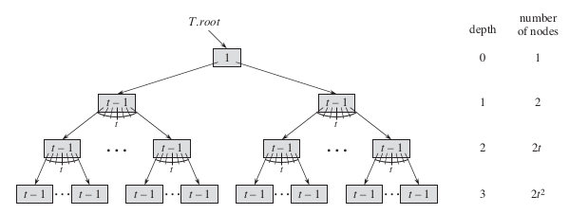
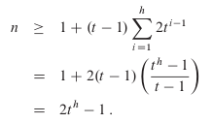
B-tree
Proof. The root contains at least one key. All other nodes has at least t-1 keys. At depth 1, there are at least 2t nodes, at depth 2, there are at least 2t² nodes. Let n be number of keys that satisfies the inequality:

Slide 15
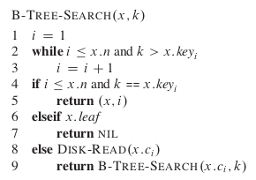
B-tree - Search
Since x.n < 2t, the while loop of lines 2-3 takes O(t) time within each node. B-TREE-SEARCH in line 9 takes O(h) = O(log_{t}n) disk pages, where h is the height of the B-tree, and n is the number of keys in the B-tree, thus the total CPU time is O(th) = O(t log_{t}n)

Slide 16
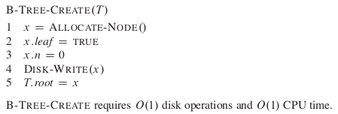
B-tree - Creating an empty tree
ALLOCATE-NODE allocates one disk page to be used as a new node in O(1) time. B-TREE-CREATE requires O(1) disk operations and O(1) CPU time

Slide 17
B-tree - Insertion
Insertion - search where the element would go and insert. While there is overflow,a node has more than 2t -1 keys, then
split the full node y into left node and right node around its median key y.key_{t}, each having only t-1 keys
The median key y.key_{t} is promoted into y’s parent as the new divider for the two new trees
If y’s parent is full, we must again split it the same way. It is possible we split all to the top
If there is no parent y, simply create a node and promote the median key into the newly created node

Slide 18
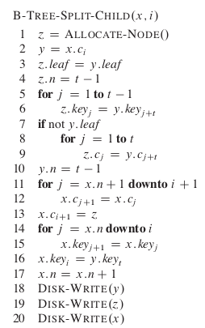
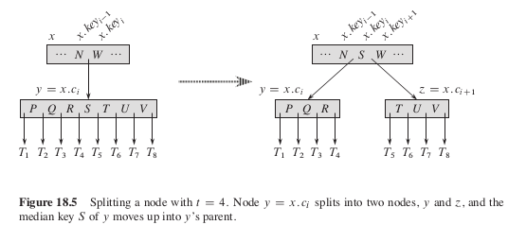
B-tree - Splitting
Line 2 -> set y as x’s ith child
Line 3 -> create z and set the leaf attribute as y
Line 4 -> number of keys in z will be t-1
Line 5-6 -> take t-1 largest keys from y
Line 7-9 -> take t largest children from y
Line 10 -> resize y
Line 11 - 13 -> set x’s new children as z
Line 14-15 -> change index
Line 16 -> insert the median to position i
Line 17 -> increase number of keys in x
Takes Θ(t) for CPU time, and O(1) for disk operations

Slide 19
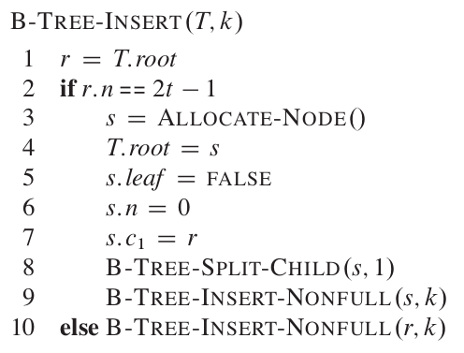
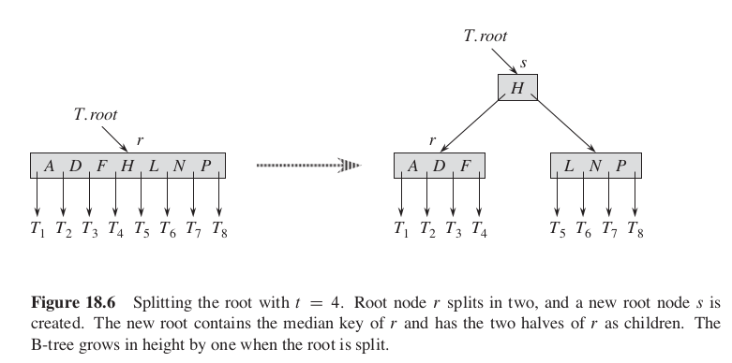
B-tree - Insertion
We insert a key k into a B-tree T of height h in a single pass down the tree, requiring O(h) disk accesses. The CPU time required is O(th) = O (t log_{t}n)
Let’s look at case when there is only one root node and we want to insert
If the keys are already 2t -1 , we will
create new s which will be the new node and will become the root
split child into two, then simply call INSERT-NONFULL(s, k)
Else, we simply call B-TREE-INSERT-NONFULL(r,k)

Slide 20
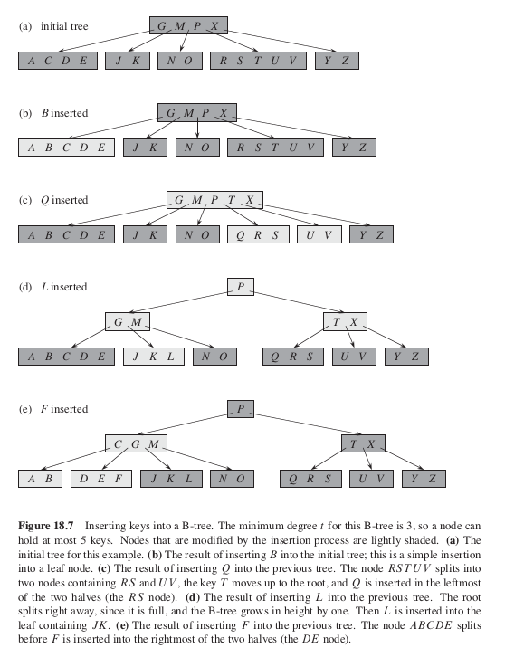
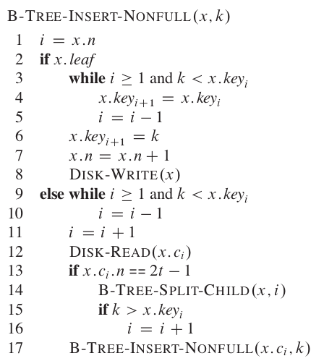
B-tree - Insertion

Slide 21
B-tree - insertion with t = 2
min children = t = 2
max children = 2t = 4
min keys = t -1 = 1
max keys = 2t - 1 = 3
Insert keys → {10, 20, 40, 50}
10

Slide 22
B-tree - insertion with t = 2
min children = t = 2
max children = 2t = 4
min keys = t -1 = 1
max keys = 2t - 1 = 3
Insert keys → {10, 20, 40, 50}
10 20

Slide 23
B-tree - insertion with t = 2
min children = t = 2
max children = 2t = 4
min keys = t -1 = 1
max keys = 2t - 1 = 3
Insert keys → {10, 20, 40, 50}
10 20 40

Slide 24
B-tree - insertion with t = 2
min children = t = 2
max children = 2t = 4
min keys = t -1 = 1
max keys = 2t - 1 = 3
Insert keys → {10, 20, 40, 50}
10 20 40 50
Overflow!
Promote the mid key to top and split left the right
40
10 20
50

Slide 25
B-tree - insertion with t = 2
min children = t = 2
max children = 2t = 4
min keys = t -1 = 1
max keys = 2t - 1 = 3
Insert 60
40
10 20
50 60

Slide 26
B-tree - insertion with t = 2
min children = t = 2
max children = 2t = 4
min keys = t -1 = 1
max keys = 2t - 1 = 3
Insert 70
40
10 20
50 60 70

Slide 27
B-tree - insertion with t = 2
min children = t = 2
max children = 2t = 4
min keys = t -1 = 1
max keys = 2t - 1 = 3
Insert 80
40
10 20
50 60 70 80
Overflow!
40 70
10 20
50 60
80

Slide 28
B-tree - insertion with t = 2
min children = t = 2
max children = 2t = 4
min keys = t -1 = 1
max keys = 2t - 1 = 3
Insert 30
40 70
10 20 30
50 60
80

Slide 29
B-tree - insertion with t = 2
min children = t = 2
max children = 2t = 4
min keys = t -1 = 1
max keys = 2t - 1 = 3
Insert 35
30 40 70
10 20
35
80
50 60

Slide 30
B-tree - insertion with t = 2
min children = t = 2
max children = 2t = 4
min keys = t -1 = 1
max keys = 2t - 1 = 3
Insert 5
30 40 70
5 10 20
35
80
50 60

Slide 31
B-tree - insertion with t = 2
min children = t = 2
max children = 2t = 4
min keys = t -1 = 1
max keys = 2t - 1 = 3
Insert 5
30 40 70
5 10 20
35
80
50 60

Slide 32
B-tree - insertion with t = 2
min children = t = 2
max children = 2t = 4
min keys = t -1 = 1
max keys = 2t - 1 = 3
Insert 15
40
15 30
70
5 10
35
80
20
50 60

Slide 33
B-tree deletion
Deletion - search where the element and delete. We need to make sure that each node is not too small, and if it is too small, we either get donations from parent, or we merge with siblings. For this algorithm to work, we go from top to bottom. Along the search path, we will make sure that cells with min. no of keys be merged, so that if the children needs “donations”, parent can always provide.
CPU time require is the same as insertion -> O(th) = O (t log_{t}n)

Slide 34
B-tree deletion
Three cases:
If key k is in node x, and x is a leaf, delete the key k from x
If key k is in node x, and x is an internal node, do the followings:
If the child y that precedes k in node x has at least t keys, then find the predecessor k’ of k in the subtree rooted at y. Recursively delete k’, and replace k by k’ in x.
If y has fewer than t keys, then, symmetrically, examine the child z that follows k in node x. If z has at least t keys, then find the successor k’ of k in the subtree rooted at z. Recursively delete k’, and replace k by k’ in x.
Otherwise, if both y and z have only t-1 keys, merge k and all of z into y, so that x loses both k and the pointer to z, and y now contains 2t-1 keys. Then free z and recursively delete k from y.

Slide 35
B-tree deletion
Three cases:
III. If the key k is not present in internal node x, determine the root x.c_{i} of the appropriate subtree that must contain k, if k is in the tree at all. If x.c_{i} has only t-1 keys, execute step 3a or 3b as necessary to guarantee that we descend to a node containing at least t keys. Then finish by recursing on the appropriate child of x.
If x.c_{i} has only t-1 keys but has an immediate sibling with at least t keys, give x.c_{i} an extra key by moving a key from x down into x.c_{i}, moving a key from x.c_{i} ’s immediate left or right sibling up into x, and moving the appropriate child pointer from the sibling into x.c_{i}.
If x.c_{i} and both of x.c_{i}’s immediate siblings have t-1 keys, merge x.c_{i} with one sibling, which involves moving a key from x down into the new merged node to become the median key for that node.

Slide 36
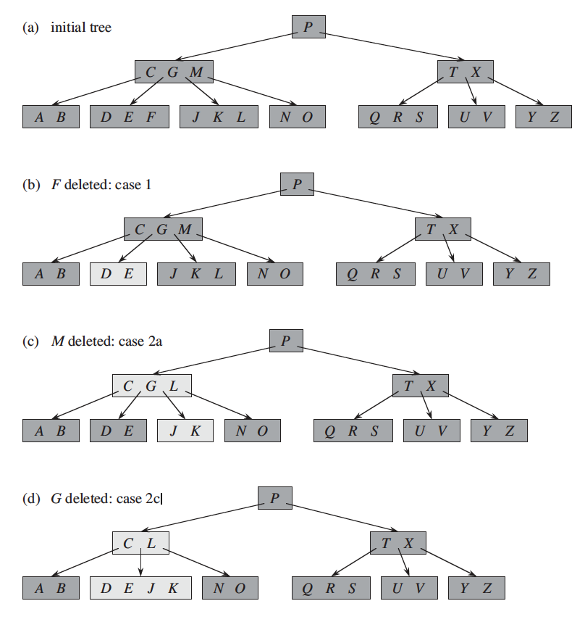
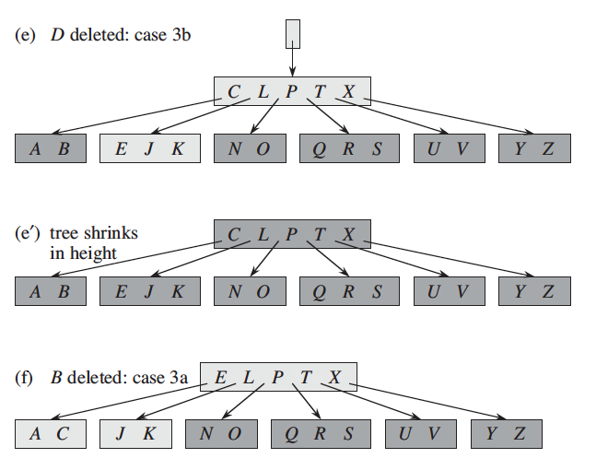

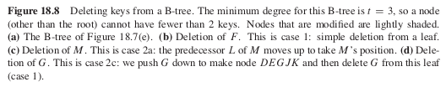
B-tree deletion (t = 3)

Slide 37
Why B-trees
Caches/Main memory read whole blocks of data, and want entire block useful
Set parameter B equal to block size
O(log_{b}(n)) block reads per Search, Insert, Delete operations.
B-Trees are used by most databases and filesystems:
Databases: MySQL, SQLite
Filesystems: MacOS HFS/HFS+, Windows NTFS, Linux ext3, shmfs

Slide 38
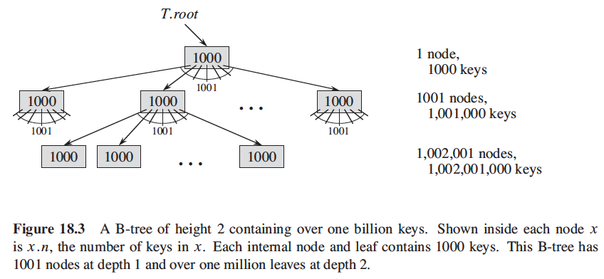
Why B-tree
A B-tree of degree 1000.
We typically want READ and WRITE to get as much information as possible, thus a B-tree node is usually as large as block size, and this size limits the number of children a B-tree node can have. Since we can keep the root node permanently in main memory, we can find any key in this tree by making at most only two disk accesses

